Slide 1
Number Theory
Chapter 4

Slide 2
Chapter Motivation
Number theory is the part of mathematics devoted to the study of the integers and their properties.
Key ideas in number theory concern
divisibility and primality of integers
representations of integers (e.g. binary and hexadecimal)
Number theory has long been studied because of the beauty of its ideas, its accessibility, and its wealth of open questions.
Number theory is considered to be pure mathematics
but it has important applications to computer science and cryptography

Slide 3
Divisibility and Modular Arithmetic
Section 4.1

Slide 4
Video 53: Division
Division
Properties of Division
Division Algorithm

Slide 5
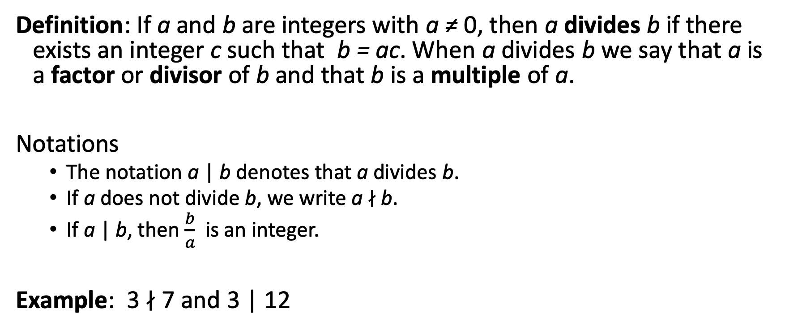
Division
Definition: If a and b are integers with a ≠ 0, then a divides b if there exists an integer c such that b = ac. When a divides b we say that a is a factor or divisor of b and that b is a multiple of a.
Notations
The notation a | b denotes that a divides b.
If a does not divide b, we write a ∤ b.
If a | b, then $\frac{b}{a}$ is an integer.
Example: 3 ∤ 7 and 3 | 12

Slide 6
Properties of Divisibility
Theorem 1: Let a, b, and c be integers, where a ≠0.
If a | b and a | c, then a | (b + c);
If a | b, then a | bc for all integers c;
If a | b and b | c, then a | c.
Proof: Direct proof of (i)
Suppose a | b and a | c, then it follows that there are integers s and t with b = as and c = at. Hence, b + c = as + at = a(s + t). Hence, a | (b + c) ◀︎

Slide 7
Properties of Divisibility
Corollary: If a, b, and c be integers, where a ≠ 0, such that a | b and a | c, then a | mb + nc whenever m and n are integers.
Proof:
By part (ii) of Theorem 1 we see that a ∣ mb and a ∣ nc whenever m and n are integers.
By part (i) of Theorem 1 it follows that a ∣ mb + nc. ◀︎

Slide 8
Division Algorithm
When an integer is divided by a positive integer, there is a quotient and a remainder.
This is traditionally called the “Division Algorithm,” but it is in fact a theorem.
Division Algorithm (Theorem 2): If a is an integer and d a positive integer, then there are unique integers q and r, with 0 ≤ r < d, such that a = dq + r

Slide 9
Notation for Division
a = dq + r
d is called the divisor.
a is called the dividend.
q is called the quotient.
r is called the remainder.
We write
q = a div d div is a function: div: N x N -> N
r = a mod d mod is a function: mod: N x N -> N

Slide 10
Example
What are the quotient and remainder when 101 is divided by 11?
101 = 9 * 11 + 2
the quotient is 101 div 11 = 9
the remainder is 101 mod 11 = 2
What are the quotient and remainder when −11 is divided by 3?
− 11 = − 4 * 3 + 1
the quotient is − 11 div 3 = − 4
the remainder is − 11 mod 3 = 1
Note: 0 ≤ r < d

Slide 11
Summary
Division
Divisibility under arithmetic operations
Division Algorithm

Slide 12
Video 54: Congruence
Congruences
Properties of congruences

Slide 13
Congruence Relation
Definition: If a and b are integers and m is a positive integer, then a is congruent to b modulo m if m divides a – b.
Notations
The notation a ≡ b (mod m) says that a is congruent to b modulo m.
We say that a ≡ b (mod m) is a congruence and that m is its modulus.
If a is not congruent to b modulo m, we write a ≢ b (mod m)

Slide 14
Example
Determine whether 17 is congruent to 5 modulo 6
17 ≡ 5 (mod 6) because 6 divides 17 − 5 = 12.
Determine whether 24 and 14 are congruent modulo 6.
24 ≢ 14 (mod 6) since 24 − 14 = 10 is not divisible by 6.

Slide 15
(mod m) and mod m Notations
The notations a ≡ b (mod m) and a mod m = b are different.
a ≡ b (mod m) is a relation on the set of integers.
In a mod m = b, the notation mod denotes a function.
Theorem 3: Let a and b be integers, and let m be a positive integer. Then a ≡ b (mod m) if and only if a mod m = b mod m.
Corollary: Two integers are congruent mod m if and only if they have the same remainder when divided by m.

Slide 16
Theorem on Congruences
Theorem 4: Let m be a positive integer. The integers a and b are congruent modulo m if and only if there is an integer k such that a = b + km.
Proof:
If a ≡ b (mod m), then by definition of congruence m | a – b. Hence, there is an integer k such that a – b = km and equivalently a = b + km.
Conversely, if there is an integer k such that a = b + km, then km = a – b. Hence, m | a – b and a ≡ b (mod m). ◀︎

Slide 17
Congruences of Sums and Products
Theorem 5: Let m be a positive integer. If a ≡ b (mod m) and c ≡ d (mod m), then a + c ≡ b + d (mod m) and ac ≡ bd (mod m).
Proof:
Because a ≡ b (mod m) and c ≡ d (mod m), by Theorem 4 there are integers s and t with b = a + sm and d = c + tm.
Therefore,
b + d = (a + sm) + (c + tm) = (a + c) + m(s + t) and
b d = (a + sm) (c + tm) = ac + m(at + cs + stm).
Hence, a + c ≡ b + d (mod m) and ac ≡ bd (mod m). ◀︎

Slide 18
Example
Because 7 ≡ 2 (mod 5) and 11 ≡ 1 (mod 5) , it follows
18 = 7 + 11 ≡ 2 + 1 = 3 (mod 5)
77 = 7 ∙ 11 ≡ 2 ∙ 1 = 2 (mod 5)

Slide 19
Algebraic Manipulation of Congruences
Multiplying both sides of a valid congruence by an integer preserves validity.
If a ≡ b (mod m) then c ∙ a ≡ c ∙ b (mod m), where c is any integer.
Proof: by Theorem 5 with d = c.
Adding an integer to both sides of a valid congruence preserves validity.
If a ≡ b (mod m) then c + a ≡ c + b (mod m), where c is any integer
Proof: by Theorem 5 with d = c.

Slide 20
Example
Since 14 ≡ 8 (mod 6) also
28 ≡ 16 (mod 6) and 20 ≡ 14 (mod 6)
Dividing both sides by 2 does not produce a valid congruence:
14/2 = 7 and 8/2 = 4, but 7 ≢ 4 (mod 6).
Dividing a congruence by an integer does not always produce a valid congruence!

Slide 21
Summary
Definition of congruences
mod m relation vs. mod function
Congruences of arithmetic operations

Slide 22
Video 55: Modular Arithmetic
Modular addition and multiplication
Properties of modular arithmetic

Slide 23
mod m Function of Products and Sums
Corollary: Let m be a positive integer and let a and b be integers. Then
(a + b) (mod m) = ((a mod m) + (b mod m)) mod m
and
a ∙ b mod m = ((a mod m) ∙ (b mod m)) mod m.
Example: 280 mod 6 = ((28 mod 6) ∙ (10 mod 6)) mod 6 = = (4 ∙ 4) mod 6 = 16 mod 6 = 4

Slide 24
Arithmetic Modulo m
Definitions: Let Z_{m} be the set of nonnegative integers less than m: Z_{m} = {0, 1, …., m − 1}
The addition modulo m operation +_{m} is defined as a +_{m} b = (a + b) mod m.
The multiplication modulo m operation ∙_{m} is defined as a ∙_{m} b = (a ∙ b) mod m.
Using these operations is said to be doing arithmetic modulo m.

Slide 25
Example
Computing 7 +₁₁ 9 and 7 ∙₁₁ 9.
Using the definitions:
7 +₁₁ 9 = (7 + 9) mod 11 = 16 mod 11 = 5
7 ∙₁₁ 9 = (7 ∙ 9) mod 11 = 63 mod 11 = 8

Slide 26
Arithmetic Modulo m
The operations +_{m} and ∙_{m} satisfy many of the properties as ordinary addition and multiplication.
Closure: If a and b belong to Z_{m} , then a +_{m} b and a ∙_{m} b belong to Z_{m} .
Commutativity: If a and b belong to Z_{m} , then a +_{m} b = b +_{m} a and a ∙_{m} b = b ∙_{m} a.
Associativity: If a, b, and c belong to Z_{m} , then (a +_{m} b) +_{m} c = a +_{m} (b +_{m} c) and (a ∙_{m} b) ∙_{m} c = a ∙_{m} (b ∙_{m} c).
Distributivity: If a, b, and c belong to Z_{m} , then a ∙_{m} (b +_{m} c) = (a ∙_{m} b) +_{m} (a ∙_{m} c) and (a +_{m} b) ∙_{m} c = (a ∙_{m} c) +_{m} (b ∙_{m} c).

Slide 27
Arithmetic Modulo m
The operations +_{m} and ∙_{m} satisfy many of the properties as ordinary addition and multiplication.
Identity elements: The elements 0 and 1 are identity elements for addition and multiplication modulo m, respectively.
If a belongs to Z_{m} , then a +_{m} 0 = a and a ∙_{m} 1 = a.
Additive inverses: If a≠ 0 belongs to Z_{m} , then m − a is the additive inverse of a modulo m and 0 is its own additive inverse:
a +_{m} (m − a) = 0 and 0 +_{m} 0 = 0

Slide 28
Commutative Ring
Multiplicative inverses have not been included since they do not always exist.
Example: There is no multiplicative inverse of 2 modulo 6.
In the terminology of abstract algebra:
Z_{m} with +_{m} is a commutative group
Z_{m} with +_{m} and ∙_{m} is a commutative ring.

Slide 29
Summary
Modular addition and multiplication
Commutative Ring

Slide 30
Integer Representations and Algorithms
Section 4.2

Slide 31
Video 56: Integer Representation
Base b representation of Integers

Slide 32
Representations of Integers
In general, we use decimal, or base 10, notation to represent integers.
Example: when we write 965, we mean 9 ∙ 10² + 6 ∙ 10¹ + 5 ∙ 10⁰ .
We can represent numbers using any base b, where b is a positive integer greater than 1.
The ancient Mayans used base 20 and the ancient Babylonians used base 60.
The bases b = 2 (binary), b = 8 (octal) , and b = 16 (hexadecimal) are important for computing and communications.

Slide 33
Base b Representations
Theorem 1: Let b be a positive integer greater than 1. Then if n is a positive integer, it can be expressed uniquely in the form:
n = a_{k}b^{k} + a_{k-1}b^{k-1} + …. + a₁b + a₀
where k is a nonnegative integer, a₀, a₁,…, a_{k} are nonnegative integers less than b, and a_{k}≠ 0. The a_{j}, j = 0, …, k are called the base-b digits of the representation.
The representation of n given in Theorem 1 is called the base b expansion of n and is denoted by (a_{k}a_{k-1}….a₁a₀)_{b}.
We usually omit the subscript 10 for base 10 expansions.

Slide 34
Binary Expansions
Most computers represent integers and do arithmetic with binary (base 2) expansions of integers.
In these expansions, the only digits used are 0 and 1.
Example: Decimal expansion of the number with binary expansion (1 0101 1111)₂
(1 0101 1111)₂ = 1∙2⁸ + 0∙2⁷ + 1∙2⁶ + 0∙2⁵ + 1∙2⁴ + 1∙2³ + 1∙2² + 1∙2¹ + 1∙2⁰ = 351

Slide 35
Octal Expansions
The octal expansion (base 8) uses the digits {0, 1, 2, 3, 4, 5, 6, 7}.
Example: Decimal expansion of the number with octal expansion (7016)₈
(7016)₈ = 7∙8³ + 0∙8² + 1∙8¹ + 6∙8⁰ = 3598

Slide 36
Hexadecimal Expansions
The hexadecimal expansion needs 16 digits.
The hexadecimal system uses the digits {0,1,2,3,4,5,6,7,8,9,A,B,C,D,E,F}.
The letters A through F represent the decimal numbers 10 through 15.
Decimal expansion of the number with hexadecimal expansion (2AE0B)₁₆ ?
(2AE0B)₁₆ = 2∙16⁴ + 10∙16³ + 14∙16² + 0∙16¹ + 11∙16⁰ = 175627

Slide 37
Base b Expansion Algorithm
procedure base_b_expansion(n, b: positive integers with b > 1)
q := n
k := 0
while (q ≠ 0)
a_{k} := q mod b
q := q div b
k := k + 1
return(a_{k-1} ,…, a₁, a₀)
{(a_{k-1} … a₁a₀)_{b} is base b expansion of n}
The digits in the base b expansion are the remainders of the division given by q mod b.

Slide 38
Example
Find the octal expansion of (12345)₁₀
Successively dividing by 8 gives:
12345 = 8 ∙ 1543 + 1
1543 = 8 ∙ 192 + 7
192 = 8 ∙ 24 + 0
24 = 8 ∙ 3 + 0
3 = 8 ∙ 0 + 3
The remainders are the digits from right to left yielding (30071)₈.

Slide 39
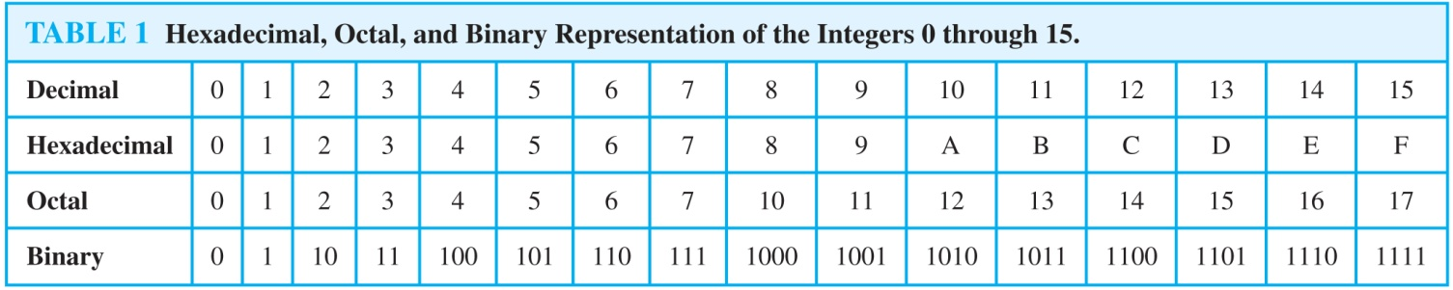
Comparison of Hexadecimal, Octal, and Binary Representations
Initial 0s are not shown
Each octal digit corresponds to a block of 3 binary digits.
Each hexadecimal digit corresponds to a block of 4 binary digits.

Slide 40
Conversion Between Binary, Octal, and Hexadecimal Expansions
Find the octal and hexadecimal expansions of (11 1110 1011 1100)₂.
To convert to octal, we group the digits into blocks of three adding initial 0s as needed. (011 111 010 111 100)₂, The blocks from left to right correspond to the digits 3, 7, 2, 7, and 4. Hence, the expansion is (37274)₈.
To convert to hexadecimal, we group the digits into blocks of four adding initial 0s as needed. (0011 1110 1011 1100)₂, The blocks from left to right correspond to the digits 3, E, B, and C. Hence, the expansion is (3EBC)₁₆.

Slide 41
Summary
Binary, Octal, and Hexadecimal Expansions
Computing an expansion
Converting among expansions

Slide 42
Video 57: Arithmetic with Base 2 Expansions
Addition
Multiplication
Modular Exponentiation

Slide 43
Binary Addition of Integers
procedure add(a, b: positive integers)
{the binary expansions of a and b are (a_{n-1}, a_{n-2},…, a₀)₂ and (b_{n-1}, b_{n-2},…, b₀)₂, respectively}
c := 0
for j := 0 to n − 1
d := ⌊(a_{j} + b_{j} + c)/2⌋
s_{j} := a_{j} + b_{j} + c − 2d
c := d
s_{n} := c
return(s₀, s₁,…, s_{n})
{the binary expansion of the sum is (s_{n}, s_{n-1},…, s₀)₂}
The number of additions of bits used by the algorithm to add two n-bit integers is O(n).

Slide 44
Example
Adding a = (1110)₂ and b = (1011)₂.
First a₀ + b₀ = 0 + 1
So d = 0, s₀ = a₀ + b₀ – 2d = 1 and c = 0
Next a₁ + b₁ + c = 1 + 1 + 0 = 2
So d = 1, s₁ = 0 and c = 1
Next a₂ + b₂ + c = 1 + 0 + 1 = 2
So d = 1, s₂ = 0 and c = 1
Finally a₃ + b₃ + c = 1 + 1 + 1 = 3
So d = 1, s₃ = 1 and c = 1
Then s₄ = c = 1 and the result is (1 1001)₂

Slide 45
Binary Multiplication
Two observations
a ∙ b = a ∙ (b_{k}2^{k} + b_{k-1}2^{k-1} + …. + b₁2 + b₀) = ab_{k}2^{k} + ab_{k-1}2^{k-1} + …. + ab₁2¹ + ab₀2⁰
Multiplying a binary number by 2^{j} is corresponds to add j zeros at the end
Example: Multiply a = (110)₂ and b = (101)₂
ab₀2⁰ = (110)₂ ∙ 1 ∙ 2⁰ = (110)₂ ∙ 2⁰ = (110)₂
ab₁2¹ = (110)₂ ∙ 0 ∙ 2¹ = (000)₂ ∙ 2¹ = (0000)₂
ab₂2² = (110)₂ ∙ 1 ∙ 2² = (110)₂ ∙ 2² = (11000)₂
finally compute the sum (110)₂ + (0000)₂ + (11000)₂ = (11110)₂

Slide 46
Binary Multiplication of Integers
procedure multiply(a, b: positive integers)
{the binary expansions of a and b are (a_{n-1}, a_{n-2},…, a₀)₂ and (b_{n-1}, b_{n-2},…, b₀)₂, respectively}
for j := 0 to n − 1
if b_{j} = 1 then c_{j} = a with j zeros appended
else c_{j} := 0
{c_{o}, c₁,…, c_{n-1} are the partial products}
p := 0
for j := 0 to n − 1
p := p + c_{j}
return p
The number of additions of bits used by the algorithm to multiply two n-bit integers is O(n²).

Slide 47
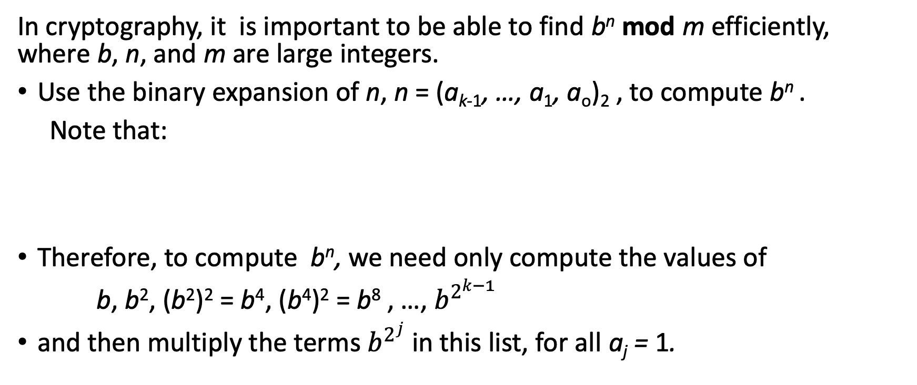
Binary Modular Exponentiation
In cryptography, it is important to be able to find b^{n} mod m efficiently, where b, n, and m are large integers.
Use the binary expansion of n, n = (a_{k-1}, …, a₁, a_{o})₂ , to compute b^{n} .
Note that:
Therefore, to compute b^{n}, we need only compute the values of
b, b², (b²)² = b⁴, (b⁴)² = b⁸ , …, $b^{2^{k−1}}$
and then multiply the terms $b^{2^{j}}$ in this list, for all a_{j} = 1.

Slide 48
Example
Example: Compute 3¹¹ using this method.
Note that 11 = (1011)₂ so that 3¹¹ = 3⁸ 3² 3¹ =
((3²)² )² 3² 3¹ = (9² )² ∙ 9 ∙3 = (81)² ∙ 9 ∙3 =6561 ∙ 9 ∙3 =117,147.

Slide 49
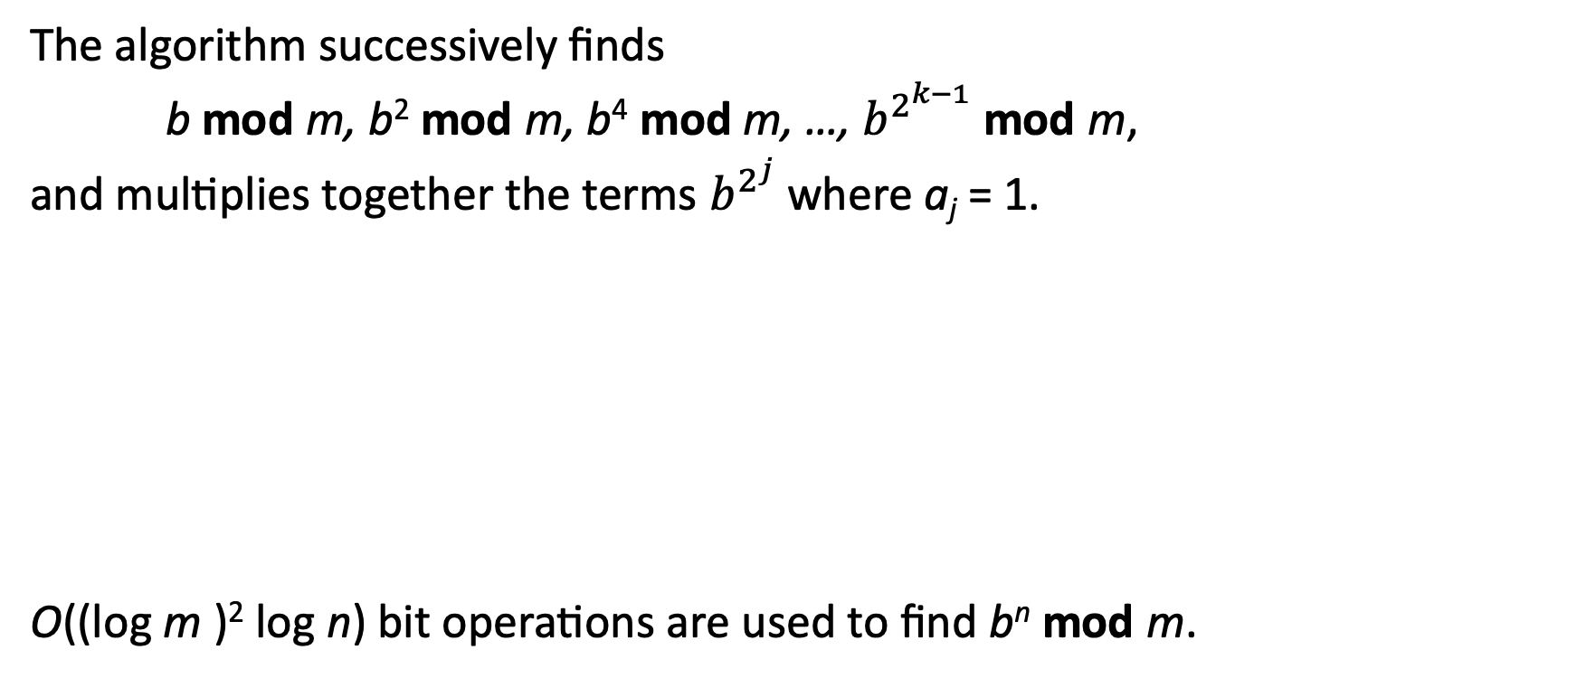
Binary Modular Exponentiation Algorithm
The algorithm successively finds
b mod m, b² mod m, b⁴ mod m, …, $b^{2^{k−1}}$ mod m,
and multiplies together the terms $b^{2^{j}}$ where a_{j} = 1.
O((log m )² log n) bit operations are used to find b^{n} mod m.
procedure modular exponentiation(b: integer, n = (a_{k-1}a_{k-2}…a₁a₀)₂ , m: positive integers)
x := 1
power := b mod m
for i := 0 to k − 1
if a_{i}= 1 then x := (x∙ power ) mod m
power := (power∙ power ) mod m
return x

Slide 50
Summary
Binary Addition and Multiplication
Complexity O(n) and O(n²)
Binary Modular Exponentiation

Slide 51
Primes and Greatest Common Divisors
Section 4.3

Slide 52
Video 58: Primes
Primes
Basic Theorems on Primes

Slide 53
Primes
Definition: A positive integer p greater than 1 is called prime if the only positive factors of p are 1 and p. A positive integer that is greater than 1 and is not prime is called composite.
Example:
The integer 7 is prime because its only positive factors are 1 and 7
The integer 9 is composite because it is divisible by 3.

Slide 54
The Fundamental Theorem of Arithmetic
Theorem: If n is an integer greater than 1, then n can be written as the product of primes.
Examples:
100 = 2 ∙ 2 ∙ 5 ∙ 5 = 2² ∙ 5²
641 = 641
999 = 3 ∙ 3 ∙ 3 ∙ 37 = 3³ ∙ 37
1024 = 2 ∙ 2 ∙ 2 ∙ 2 ∙ 2 ∙ 2 ∙ 2 ∙ 2 ∙ 2 ∙ 2 = 2¹⁰

Slide 55
Proof of Fundamental Theorem of Arithmetic
Proof: (strong induction) Let P(n) be the proposition that n can be written as a product of primes.
BASIS STEP: P(2) is true since 2 itself is prime.
INDUCTIVE STEP: The inductive hypothesis is P(j) is true for all integers j with 2 ≤ j ≤ k. To show that P(k + 1) must be true under this assumption, two cases need to be considered:
If k + 1 is prime, then P(k + 1) is true.
Otherwise, k + 1 is composite and can be written as the product of two positive integers a and b with 2 ≤ a ≤ b < k + 1. By the inductive hypothesis a and b can be written as the product of primes and therefore k + 1 can also be written as the product of those primes.
Hence, it has been shown that every integer greater than 1 can be written as the product of primes. ◀︎

Slide 56
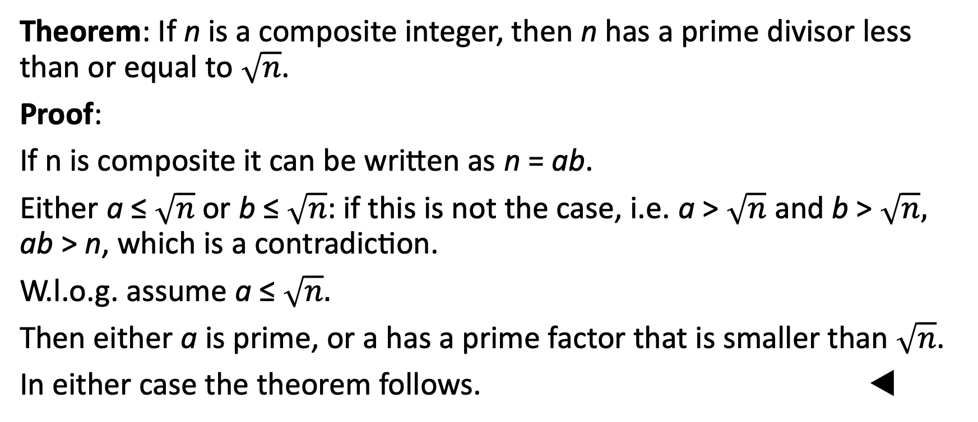
Trial Division
Theorem: If n is a composite integer, then n has a prime divisor less than or equal to $\sqrt{n}$.
Proof:
If n is composite it can be written as n = ab.
Either a ≤ $\sqrt{n}$ or b ≤ $\sqrt{n}$: if this is not the case, i.e. a > $\sqrt{n}$ and b > $\sqrt{n},$ ab > n, which is a contradiction.
W.l.o.g. assume a ≤ $\sqrt{n}.$
Then either a is prime, or a has a prime factor that is smaller than $\sqrt{n}$.
In either case the theorem follows. ◀︎

Slide 57
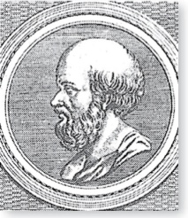
The Sieve of Erastosthenes
Erastothenes
(276-194 B.C.)
The Sieve of Erastosthenes can be used to find all primes not exceeding a specified positive integer. For example, begin with the list of integers between 1 and 100.
Delete all the integers, other than 2, divisible by 2.
Delete all the integers, other than 3, divisible by 3.
Next, delete all the integers, other than 5, divisible by 5.
Next, delete all the integers, other than 7, divisible by 7.
Since all the remaining integers are not divisible by any of the previous integers, other than 1, the primes are:
{2,3,5,7,11,15,1719,23,29,31,37,41,43,47,53,59,61,67,71,73,79,83,89, 97}

Slide 58
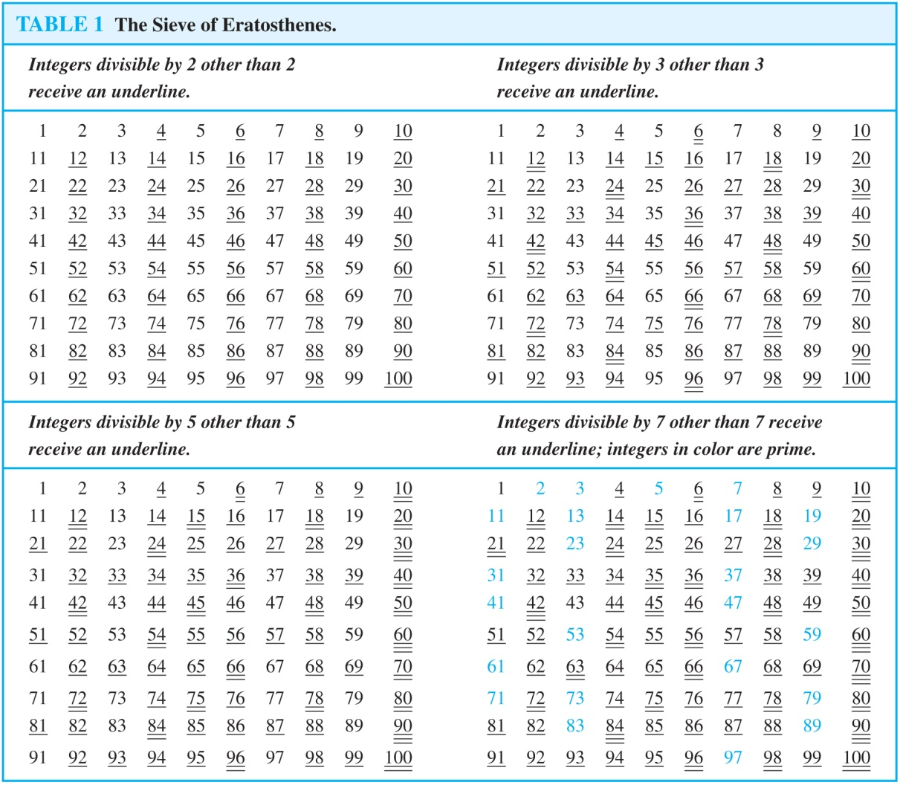
The Sieve of Erastosthenes

Slide 59
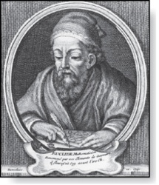
Infinitude of Primes
Euclid
(325 B.C.E. – 265 B.C.E.)
Theorem: There are infinitely many primes (Euclid).
Proof: Assume finitely many primes: p₁, p₂, ….., p_{n}
Let q = p₁p₂∙∙∙ p_{n} + 1
Either q is prime or by the fundamental theorem of arithmetic it is a product of primes.
None of the primes p_{j} divides q since if p_{j} | q, then p_{j} divides q − p₁p₂∙∙∙ p_{n} = 1 .
Hence, there is a prime not on the list p₁, p₂, ….., p_{n}.
It is either q, or if q is composite, it is a prime factor of q.
This contradicts the assumption that p₁, p₂, ….., p_{n} are all the primes.
Consequently, there are infinitely many primes. ◀︎

Slide 60
Summary
Primes
Basic Theorems on Primes
Fundamental Theorem of Arithmetic
Trial Division
Sieve of Erastosthenes
Euclid’s Theorem

Slide 61
Video 59: GCD and LCM
Greatest common divisor
Least common Multiple

Slide 62
Greatest Common Divisor
Definition: Let a and b be integers, not both zero. The largest integer d such that d | a and also d | b is called the greatest common divisor of a and b.
The greatest common divisor of a and b is denoted by gcd(a, b).
Example:
gcd(24, 36) = 12
gcd(17, 22) = 1
gcd(17, 0) = 17

Slide 63
Relatively Prime
Definition: The integers a and b are relatively prime if gcd(a, b) = 1
Definition: The integers a₁, a₂, …, a_{n} are pairwise relatively prime if gcd(a_{i}, a_{j}) = 1 whenever 1 ≤ i < j ≤ n.

Slide 64
Examples
17 and 22 are relatively prime
The integers 10, 17 and 21 are pairwise relatively prime.
gcd(10, 17) = 1
gcd(10, 21) = 1
gcd(17, 21) = 1
The integers 10, 19, and 24 are not pairwise relatively prime.
gcd(10, 24) = 2

Slide 65
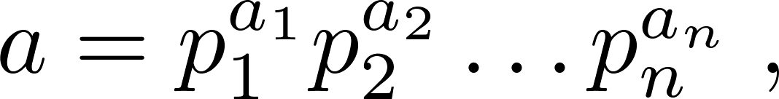
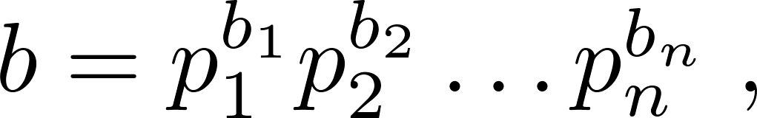
Finding the Greatest Common Divisor
Suppose the prime factorizations of a and b are:
where each exponent is a nonnegative integer. Then:
Finding the gcd of two positive integers using their prime factorizations is not efficient because there is no efficient algorithm for finding the prime factorization of a positive integer.

Slide 66
Example
120 = 2³ ∙ 3 ∙ 5 = 2³ ∙ 3¹ ∙ 5¹
500 = 2² ∙ 5³ = 2² ∙ 3⁰ ∙ 5³
Then
gcd(120, 500) = 2^{min(3,2)} ∙ 3^{min(1,0)} ∙ 5^{min(1,3)} = 2² ∙ 3⁰ ∙ 5¹ = 20

Slide 67
Least Common Multiple
Definition: The least common multiple of the positive integers a and b is the smallest positive integer that is divisible by both a and b. It is denoted by lcm(a, b).
The least common multiple can also be computed from the prime factorizations.
Example: lcm(2³3⁵7², 2⁴3³) = 2^{max(3,4)} 3^{max(5,3)} 7^{max(2,0)} = 2⁴ 3⁵ 7²
Theorem: Let a and b be positive integers. Then ab = gcd(a, b) ∙ lcm(a, b)

Slide 68
Euclidean Algorithm
The Euclidian algorithm is an efficient method for computing the greatest common divisor of two integers.
It is based on the idea that gcd(a, b) is equal to gcd(r, b) when a > b and r is the remainder when a is divided by b.
Example:
Find gcd(91, 287):
287 = 91 ∙ 3 + 14, therefore gcd(287, 91) = gcd(14, 91) = gcd(91, 14)
91 = 14 ∙ 6 + 7, therefore gcd(91, 14) = gcd(7, 14) = gcd(14, 7)
14 = 7 ∙ 2 + 0, therefore gcd(14, 7) = 7

Slide 69
Correctness of Euclidean Algorithm
Lemma 1: Let a = bq + r, where a, b, q, and r are integers. Then gcd(a, b) = gcd(b, r).
Proof:
Suppose that d divides both a and b. Then d also divides a − bq = r.
Hence, any common divisor of a and b must also be a common divisor of b and r.
Suppose that d divides both b and r. Then d also divides bq + r = a.
Hence, any common divisor of b and r must also be a common divisor of a and b.
Therefore, gcd(a, b) = gcd(b, r). ◀︎

Slide 70
Euclidean Algorithm
procedure gcd(a, b: positive integers, a > b)
x := a
y := b
while y ≠ 0
r := x mod y
x := y
y := r
return x
procedure gcd(a, b: positive integers, a > b)
if b = 0 then return a
else return gcd(b, a mod b)

Slide 71
Correctness of Euclidean Algorithm
Suppose that a and b are positive integers with a ≥ b. Let r₀ = a and r₁ = b.
Successive applications of the division algorithm yields:
Eventually, a remainder of zero occurs in the sequence of terms: a = r₀ > r₁ > r₂ > ∙ ∙ ∙ ≥ 0. The sequence can’t contain more than a terms.
By Lemma 1 gcd(a,b) = gcd(r₀,r₁) = ∙ ∙ ∙ = gcd(r_{n-1},r_{n}) = gcd(r_{n} , 0) = r_{n}.
Hence the greatest common divisor is the last nonzero remainder in the sequence of divisions.
r₀ = r₁q₁ + r₂ 0 ≤ r₂ < r₁,
r₁ = r₂q₂ + r₃ 0 ≤ r₃ < r₂,
∙
∙
∙
r_{n-2} = r_{n-1}q_{n-1} + r₂ 0 ≤ r_{n} < r_{n-1},
r_{n-1} = r_{n}q_{n} .

Slide 72
Complexity of Euclidean Algorithm
Theorem (Lamé’s theorem): Let a and b be positive integers with a ≥ b. Then the number of divisions used by the Euclidean algorithm to find gcd(a, b) is less than or equal to five times the number of decimal digits in b.
Therefore the Euclidean algorithm has complexity O(log b).

Slide 73
Summary
Greatest common divisor
Least common Multiple
Euclidean Algorithm

Slide 74
Video 60: More Facts about Primes
Important facts about Primes
Finding large Primes
Open problems on Primes

Slide 75
Uniqueness of Prime Factorization
Theorem: If p is a positive integer then its factorization into primes of non-decreasing order is unique.

Slide 76
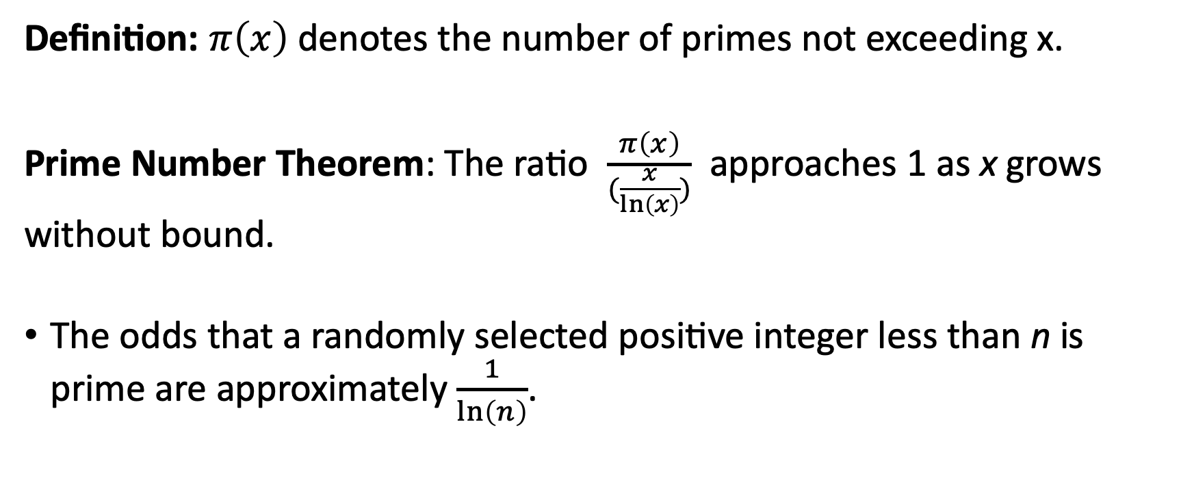
Distribution of Primes
Definition: $π\left(x\right)$ denotes the number of primes not exceeding x.
Prime Number Theorem: The ratio $\frac{π\left(x\right)}{(\frac{x}{\ln\left(x\right)})}$ approaches 1 as x grows without bound.
The odds that a randomly selected positive integer less than n is prime are approximately $\frac{1}{\ln\left(n\right)}$.

Slide 77
Primes and Arithmetic Progressions
Are there long arithmetic progressions made up entirely of primes?
5, 11, 17, 23, 29 is an arithmetic progression of five primes.
199, 409, 619, 829, 1039, 1249, 1459, 1669, 1879, 2089 is an arithmetic progression of ten primes.
In the 1930s, Paul Erdős conjectured that for every positive integer n greater than 1, there is an arithmetic progression of length n made up entirely of primes.
This was proven in 2006, by Ben Green and Terrence Tau.

Slide 78
Mersene Primes
Definition: Prime numbers of the form 2^{p} − 1 , where p is prime, are called Mersene primes.
Examples
2² − 1 = 3, 2³ − 1 = 7, 2⁵ − 1 = 37 , and 2⁷ − 1 = 127 are Mersene primes.
2¹¹ − 1 = 2047 is not a Mersene prime since 2047 = 23∙89.
There is an efficient test for determining if 2^{p} − 1 is prime.
The largest known prime numbers are Mersene primes.
As of mid 2018, the largest is 2^{82,589,933} − 1, which has nearly 25 million decimal digits.
The Great Internet Mersene Prime Search (GIMPS) is a distributed computing project to search for new Mersene Primes. http://www.mersenne.org/

Slide 79
Conjectures
Goldbach’s Conjecture: Every even integer n, n > 2, is the sum of two primes.
It has been verified by computer for all positive even integers up to 1.6 ∙10¹⁸.
The conjecture is believed to be true by most mathematicians.
The Twin Prime Conjecture: There are infinitely many pairs of twin primes. Twin primes are pairs of primes that differ by 2.
Examples are 3 and 5, 5 and 7, 11 and 13, etc.
The current world’s record for twin primes (as of 2018) consists of numbers 2996863034895 · 2¹²⁹⁰⁰⁰⁰ ± 1, which have 388,342 decimal digits.

Slide 80
Summary
Uniqueness of Prime Factorization
Distribution of Primes
Primes and Arithmetic Progressions
Mersene Primes
Goldbach’s Conjecture
The Twin Prime Conjecture

